Slide 1
Software Architecture

Slide 2
Software Architecture
Software Architecture consists of One Tier, Two Tier, Three Tier and N-Tier architectures.
A “tier” can also be referred to as a “layer”

Slide 3
Layers involved in an Software
Presentation Layer
Application / Business Layer
Data Layer

Slide 4
Presentation Layer
It is also known as Client layer. Top most layer of an application.
This is the layer we see when we use a software.
By using this layer we can access rendered webpages.
The main functionality of this layer is to communicate user with Application.

Slide 5
Presentation Layer
This layer passes the information which is given by the user in terms of keyboard actions, mouse clicks to the Application Layer.
For example, login page of Gmail where an end user could see text boxes and buttons to enter user id, password and to click on sign-in.

Slide 6
Application Layer
It is also known as Business Logic Layer. It controls an application’s functionality by performing detailed processing.
This layer acts as a mediator between the Presentation and the Data layer. Complete business logic will be written in this layer.
As per the gmail login page example, once user clicks on the login button, Application layer interacts with Data layer and sends required information to the Presentation layer.

Slide 7
Data Layer
The data is stored in this layer. Application layer communicates with Database layer to retrieve the data. It contains methods that connects the database and performs required action e.g.: insert, update, delete etc.

Slide 8
Types of Software Architecture
One Tier Architecture
Two-Tier Architecture
Three-Tier Architecture
N-Tier Architecture

Slide 9
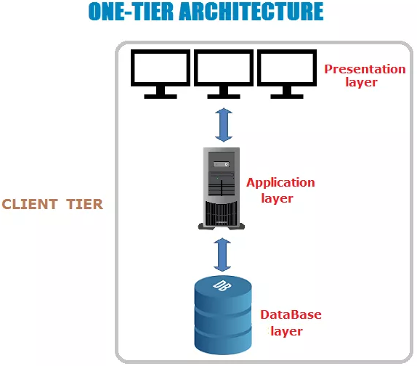
One Tier Architecture

Slide 10
One Tier Architecture
One Tier application AKA Standalone application.
One tier architecture has all the layers such as Presentation, Business, Data Access layers in a single software package.
Applications which handles all the three tiers such as MP3 player, MS Office are come under one tier application.
The data is stored in the local system or a shared drive.

Slide 11
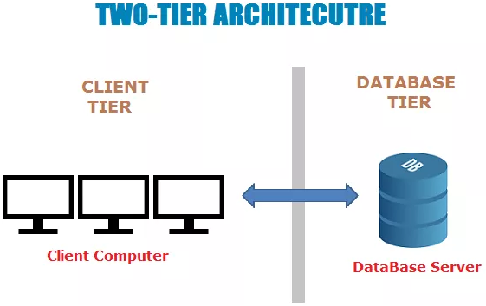
Two-Tier Architecture

Slide 12
Two-Tier Architecture
Two Tier application AKA Client-Server application.
The Two-tier architecture is divided into two parts:
Client Application (Client Tier)
Database (Data Tier)
Client system handles both Presentation and Application layers.
Server system handles Database layer.

Slide 13
Two-Tier Architecture
The communication takes place between the Client and the Server.
Client system sends the request to the Server system and the Server system processes the request and sends back the data to the Client System.

Slide 14
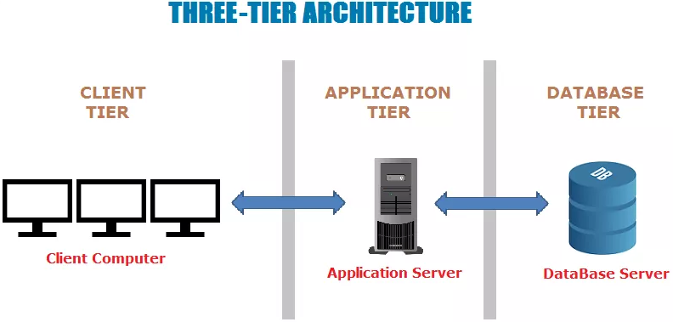
Three-Tier Architecture

Slide 15
Three-Tier Architecture
Three Tier application AKA Web Based application.
The Three-tier architecture is divided into three parts:
Presentation layer (Client Tier)
Application layer (Business Tier)
Database layer (Data Tier)
Client system handles Presentation layer, Application server handles Application layer and Server system handles Database layer.

Slide 16
N-Tier Architecture
N-Tier application AKA Distributed application.
It is similar to three tier architecture but number of application servers are increased and represented in individual tiers in order to distributed the business logic so that the logic will be distributed.

